Slide 1

Amalgamation (Jan 2016 – May 2016)
- Kishan A V

Slide 2

Agenda
Before Joining Canon : Overview
Lessons learnt at Canon
PERL Programming
UNIX and Shell Programming
VHDL and Verilog
System Verilog
Hardware Implementation

Slide 3
Before Joining CANON : Overview
Worked on Linux platform for simple applications.
Knew only C programming and Java.
Learnt basics of Verilog.
Interested towards VLSI, Artificial Intelligence and concepts related to Image Processing.

Slide 4
Lessons learnt at Canon
VHDL & Verilog
Perl Unix Shell Script
System Verilog
Modules for demonstration of Designs

Slide 5
PERL Programming
First scripting language undertaken for learning.
Perl is quite a user friendly language which allows user to code in his style(no predefined rules and indents).
Two slogans in PERL include :
"There's more than one way to do it“
"Easy things should be easy and hard things should be possible".
The language is more practical, has cross platform application and a large collection of modules.

Slide 6
PERL Programming
Learning Involved-
Language Style
Building control flow constructs
Looping Statements
File I/O
Formatting
Referencing and Dereferencing
Concept of MAKE File

Slide 7
PERL Programming - Exercise
Basic PERL exercises like sorting names from a file was performed.
Similar exercise involving marks was performed from text and excel files.
A Make file is one that instructs the program make how to compile and link a program. It helps in compiling the part of the code which is modified and which is dependent on the modifications.
Make files for the exercises was developed and linked with different programs.

Slide 8
UNIX and Shell Programming
Most widely used Development Platform.
Open Source and implements less of user interface.
Allows the user to experience the working unlike some of the GUI based systems.
Allows multifunctional programming and invoking by using terminal.

Slide 9
UNIX and Shell Programming
Learning Involved-
Getting stated with teminal
File Hierarchy System
Shell commands for some of the operations involving creation and deletion
Concept of Bash file and Make File
Concept of Macros and its implemetation

Slide 10
VHDL and Verilog
Well known Hardware Descriptive Language widely used all over the globe.
Having known the basics of Verilog, it was easy to learn the pre-Verilog version i.e.”VHDL”.
VHDL is strongly typed and is known for the standard coding style. This feature gives less flexibility but helps a new person understand the code easily.

Slide 11
VHDL and Verilog
Learning Involved-
Language Style
Building control flow statements
Looping Statements
Concepts of Entity, Process, Architecture, Components and Packages
Concepts of Concurrent and Sequential codes.
Implementation of flip flops and counter using VHDL and Verilog
Getting used to Cadence tool.
Simulation and waveform generation using a Testbench
Comparative study of VHDL and Verilog understanding the differences between them.

Slide 12
Use of Verilog and VHDL
Used Verilog and VHDL till date for development of design and its verification.
It was used for the design of some basic blocks like :
Flip flop
Multiplexer
Counter

Slide 13
Hardware Implementation
Counter
Memory
Synch FIFO (one clock)
Synch FIFO (multi clock)
Asynch FIFO

Slide 14
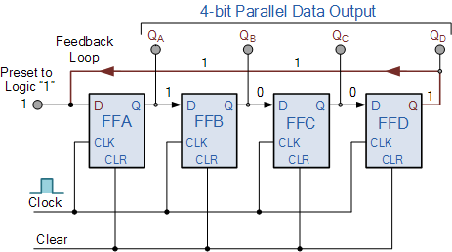
Counter Design

Slide 15
Counter Design
Design of a synchronous and asynchronous counter using both Verilog and VHDL.
Inputs:
Clock
Reset
Enable
Outputs:
Count
Depth(generic variable)
Verilog and VHDL test benches were developed for the same.

Slide 16
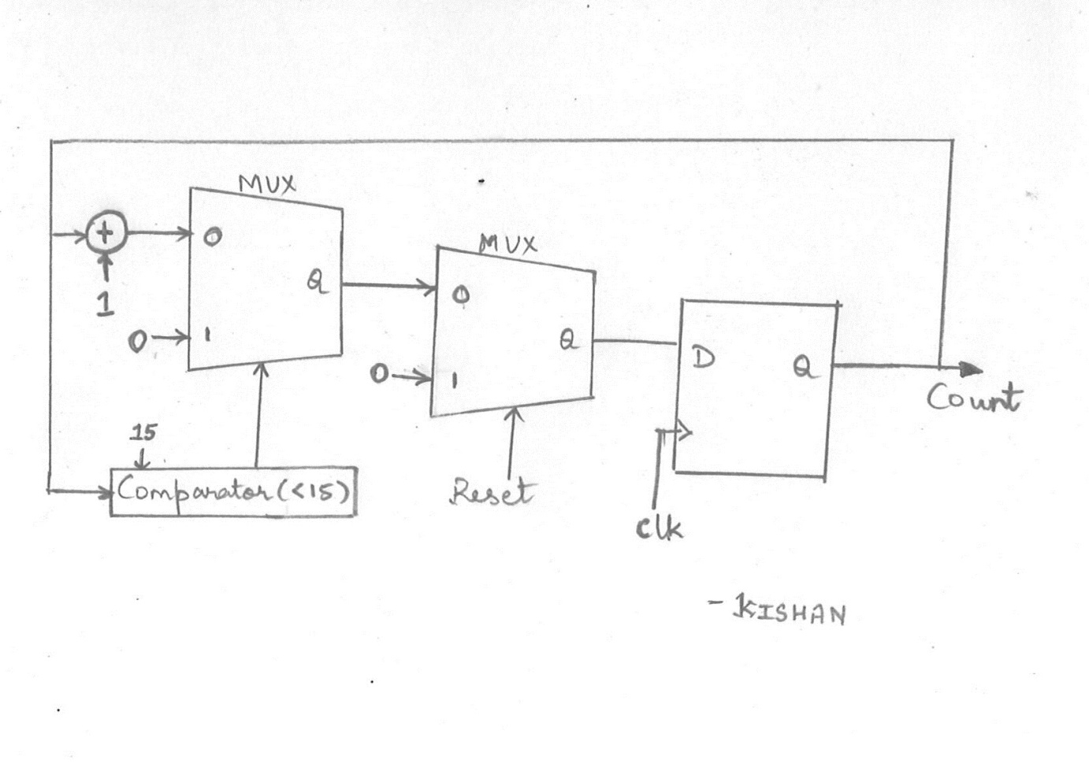
Hardware realization of Counter

Slide 17
Memory Design
Design of a memory using both Verilog and VHDL.
Inputs:
Write Enable
Read Enable
Read pointer
Write pointer
Data in
Output:
Data out
Verilog and VHDL test benches were developed for the same.

Slide 18
FIFO Design
Design of a FIFO using VHDL.
Inputs:
Push
Pop
Clock
Reset
Data in
Output:
Data out
Full
Empty
Almost Full
Almost Empty
Depth, width and Threshold were used as parameters.
Verilog and VHDL test benches were developed for the same.

Slide 19
FIFO Design
Single Controller based design for the FIFO was developed making use of only one clock for both read and write operations.
Practically a read and write clock is used for the same.
The design had to have two clocks: read clock and write clock.
Then came of problem of metastability in states due to clock domain crossing

Slide 20
Metastability
Metastability is a quasi stable state where is output is unpredictable.
Causes :
Input is asynchronous
Clock skew is low
Two domains operate at two different frequencies or same frequency with different phase.
Flip Flop input changes in critical window (steup or hold)

Slide 21
Metastability
Solution to metastability :
Two Flip Flop Synchronizer
Toggle Synchronizer
Handshake based Pulse Synchronizer
Gray Encoding
Recirculation Mux Synchronizer
In the case of FIFO Two Flip Flop Synchronizer and Gray Encoding is relavant

Slide 22
Redesign of FIFO using CDC
Some of the VHDL modules for the same include :
Dff1.vhd
Dff2.vhd
BtoG.vhd
GtoB.vhd
Xorgate.vhd
Write_control.vhd
Read_control.vhd
Mem.vhd
Controller.vhd

Slide 23
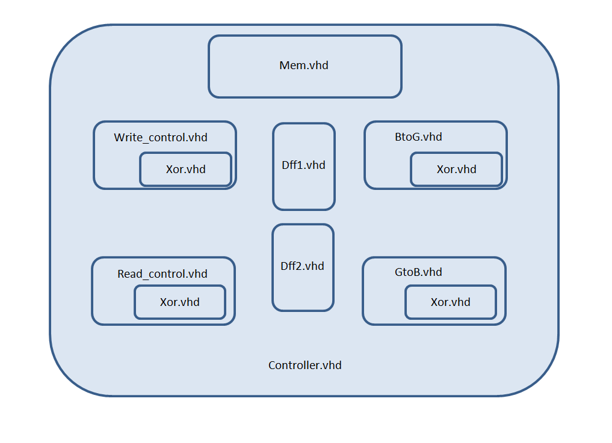
Instantiation Diagram of FIFO using CDC

Slide 24
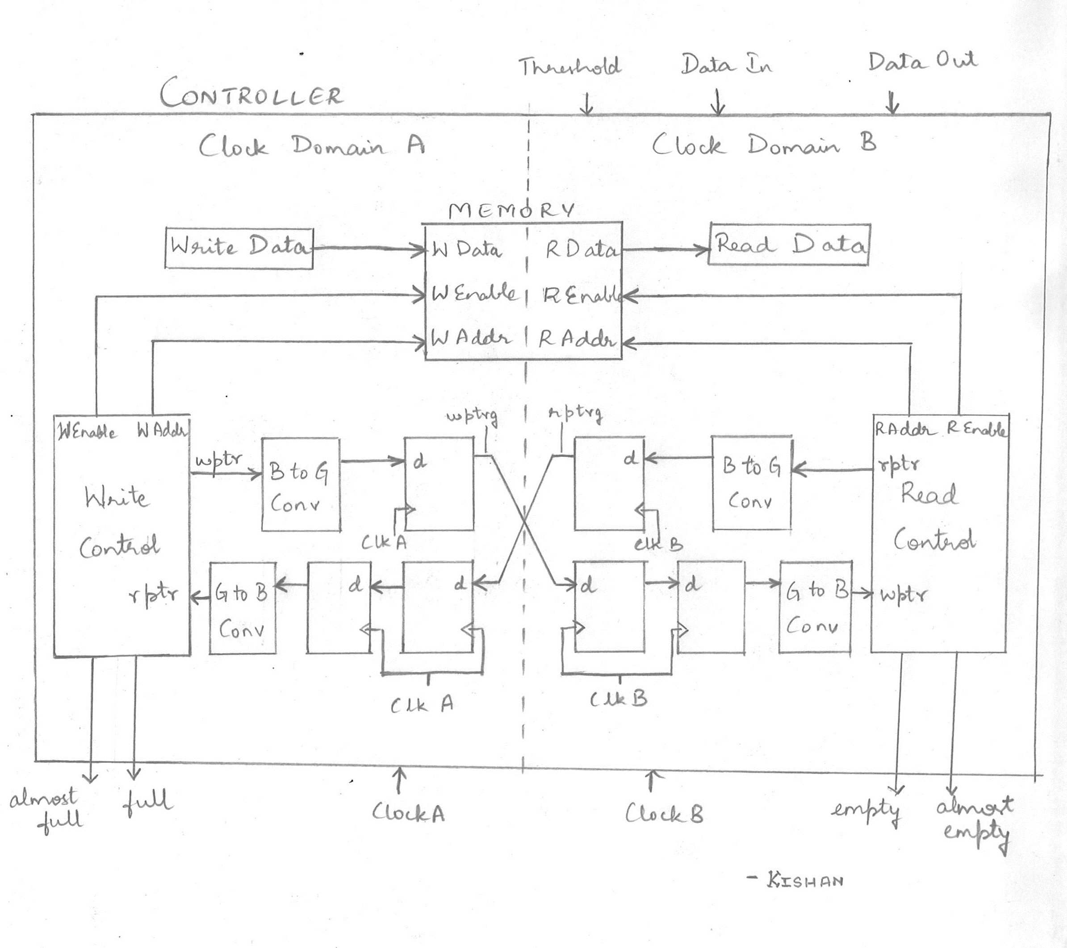
Block Diagram of FIFO using CDC

Slide 25
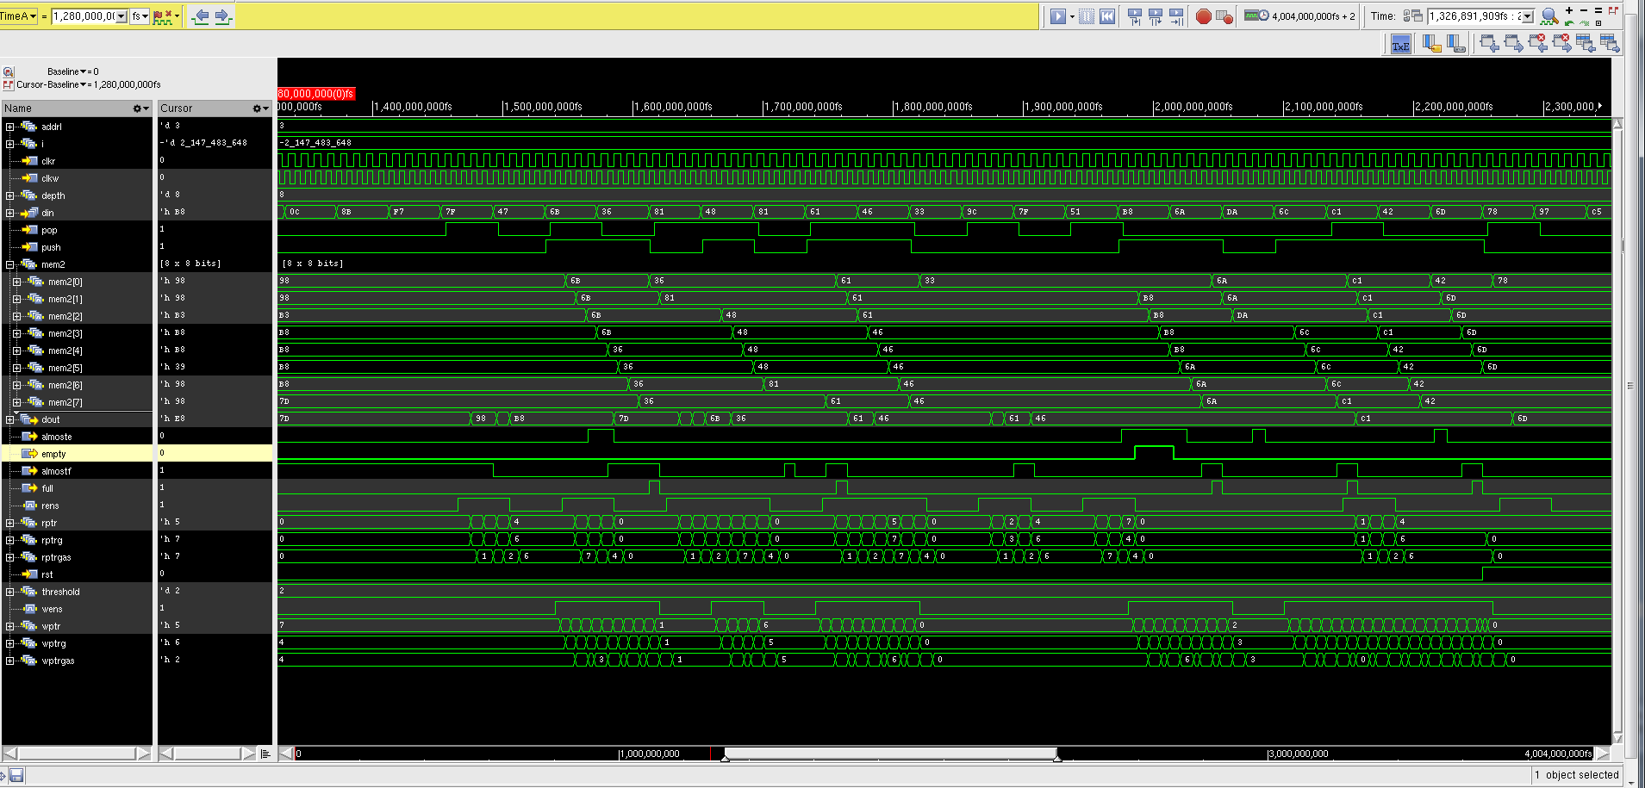
Waveforms of FIFO using CDC

Slide 26
Use of Verilog and VHDL
I have used Verilog and VHDL till date for development of design and its verification.
Developed basic test benches for verification.
Verification was done using
Simulation outputs
Waveforms

Slide 27
Introduction to System Verilog
System Verilog is a combined Hardware descriptive language and Hardware verification language based on extensions to Verilog.
SV helps us in quantitatively analysing the design with a very systematic Test bench.
With SV, we can analyze loopholes in the existing design easily and correct them as and when required.

Slide 28
Additions in System Verilog
Some of the new features in System Verilog are as listed below.
C type data types like int, typedef, struct, union, enum.
Dynamic data types : struct, classes, dynamic queues, dynamic arrays
New operators and built in methods
Enhanced flow control like, foreach, return, break, continue
Semaphores, mailboxes, event extensions
Classes for object oriented programming
Assertions
Coverage

Slide 29
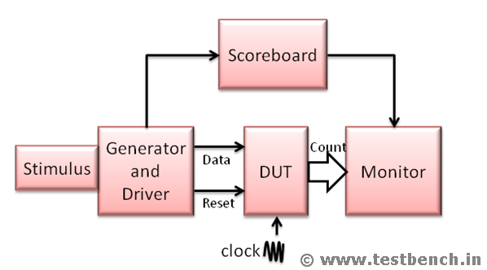
Basic Block Diagram of System Verilog Testbench

Slide 30
Counter Testbench Overview
Some of the Assertions and test coverage includes:
Reset pin setting the count to zero within stipulated number of clock cycles.
Rollover of the counter when it is full.
Covering all cross possibilities of reset and enable pins to verify the case.
Checking that the devices are clock sensitive and work in synchronous with the positive edge of the clock.

Slide 31
Counter Testbench Coverage Results
Some of the results include:
100% coverage to all the values of the counter
100% coverage to all the cross coverage features of the reset and enable pins
100% coverage to the coverpoint involving the rollover of the count variable
Verification of the Reset and an assertion in case of an error in the design.

Slide 32
FIFO Testbench
Some of the components of the test bench include:
Interface.sv
Randomization .sv
Test.sv
Checker.sv
Top.sv

Slide 33
FIFO Testbench Overview
Some of the test coverage cases includes:
All the read and write pointer addresses are covered i.e. from 0 to N
The read and write pointer addresses roll over after reaching N.
Read and write pointer addresses increment when the read and write enable is made high respectively.
All the states of Write enable are covered
All the states of Read enable are covered
All the states of Reset are covered
All the states of full and empty flags are covered
All the states of almost full and almost empty flags are covered
Cross Coverage for read enable, write enable and reset is covered with all possible combinations of the same.

Slide 34
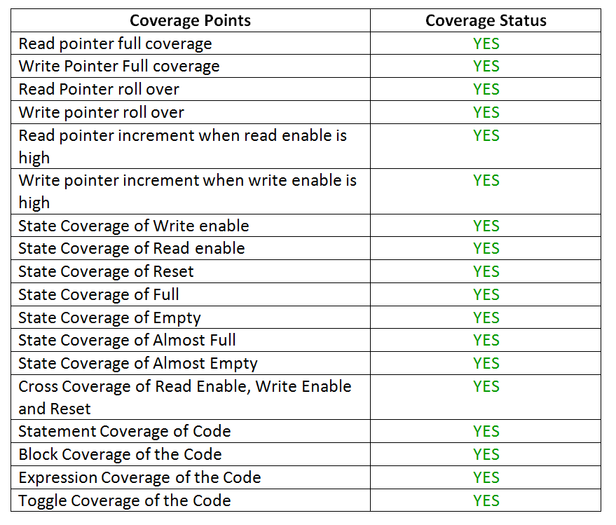
FIFO Testbench Coverage Results

Slide 35
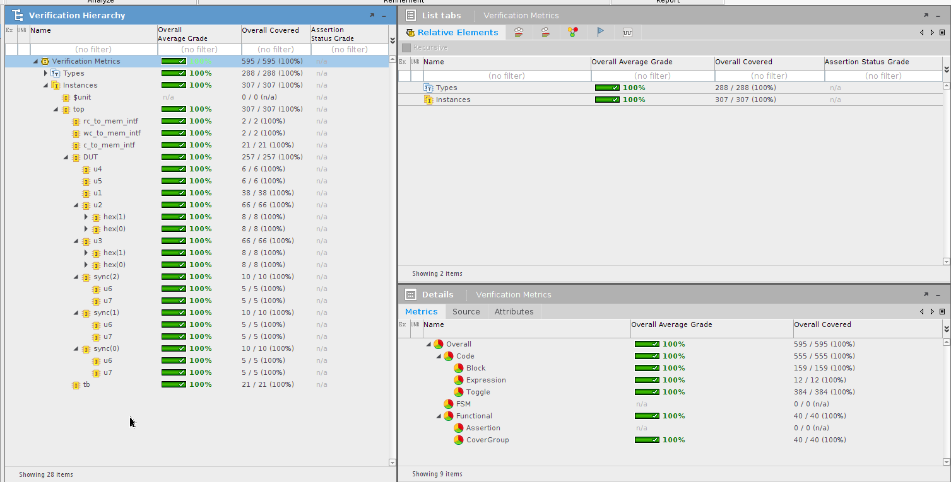
FIFO Testbench Coverage Results: Top View

Slide 36
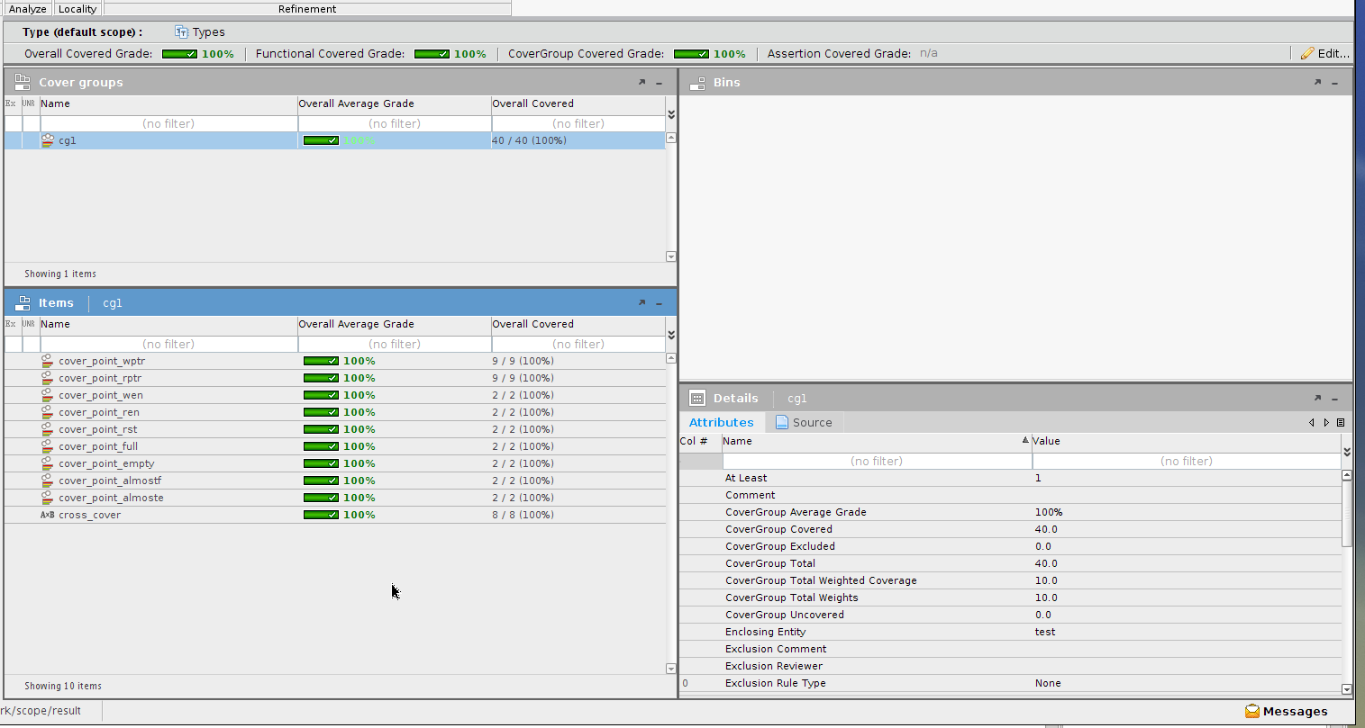
FIFO Testbench Cover group Analysis

Slide 37
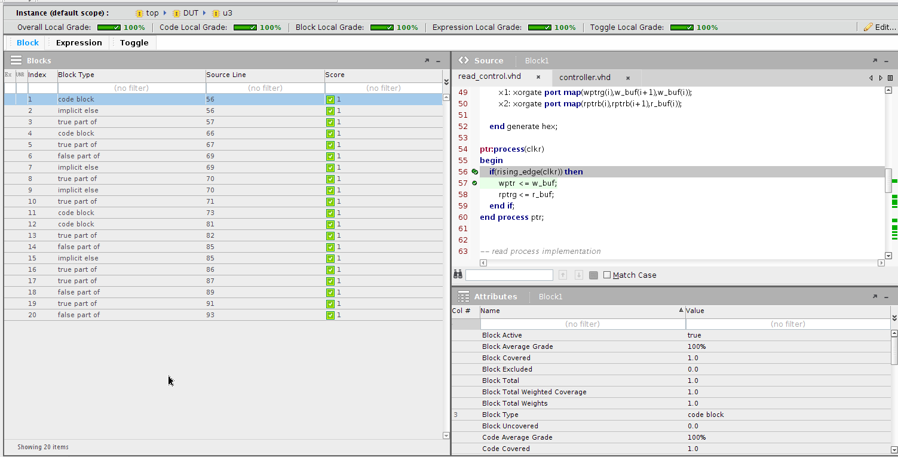
FIFO Testbench Block Coverage Results

Slide 38
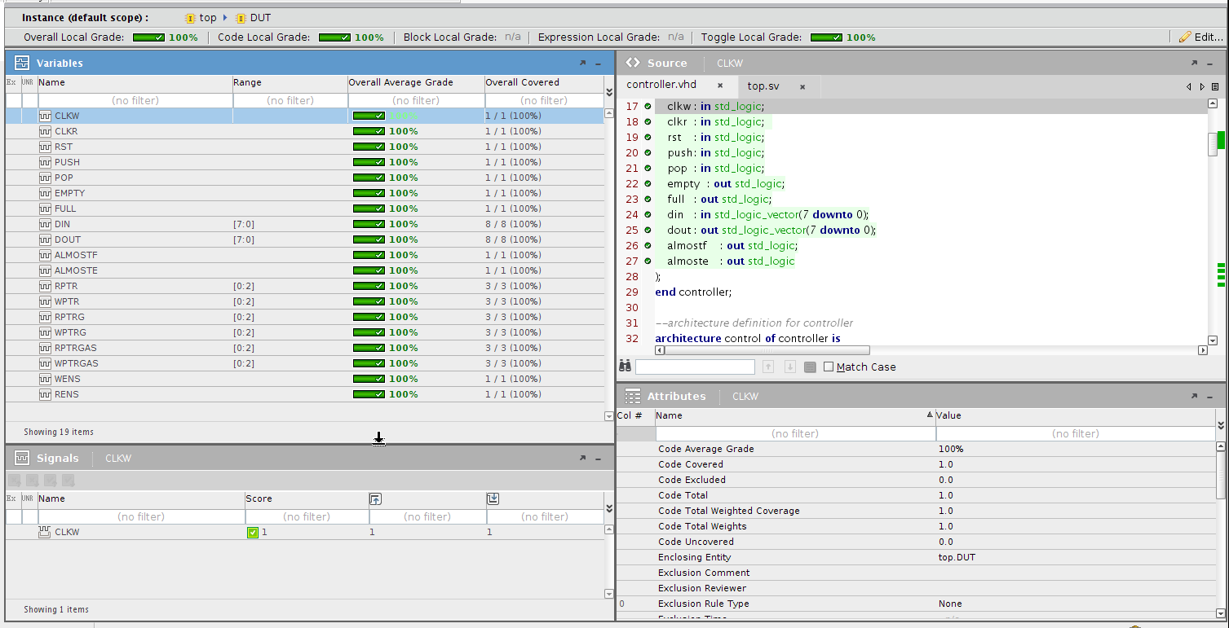
FIFO Testbench Toggle Coverage Results

Slide 39
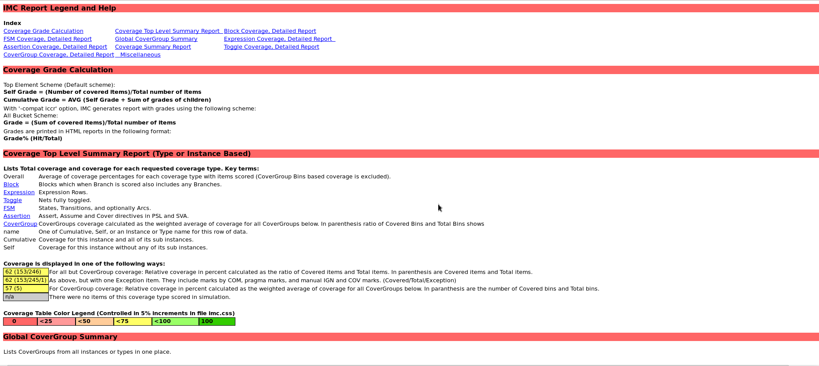
FIFO Testbench Coverage: Legend

Slide 40
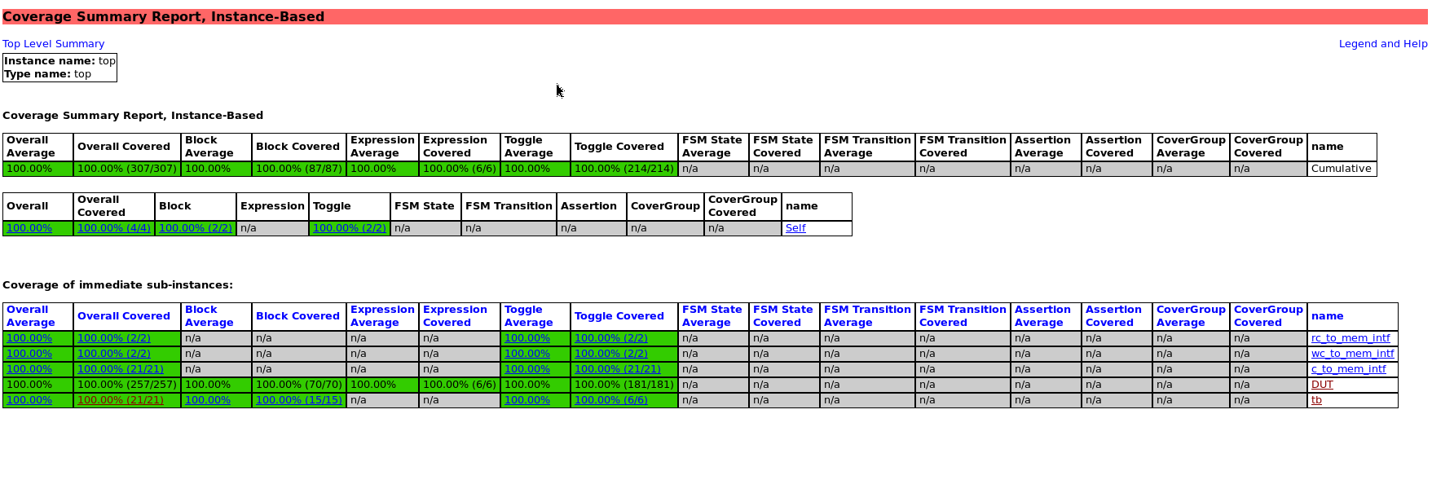
FIFO Testbench Coverage Results: Top

Slide 41
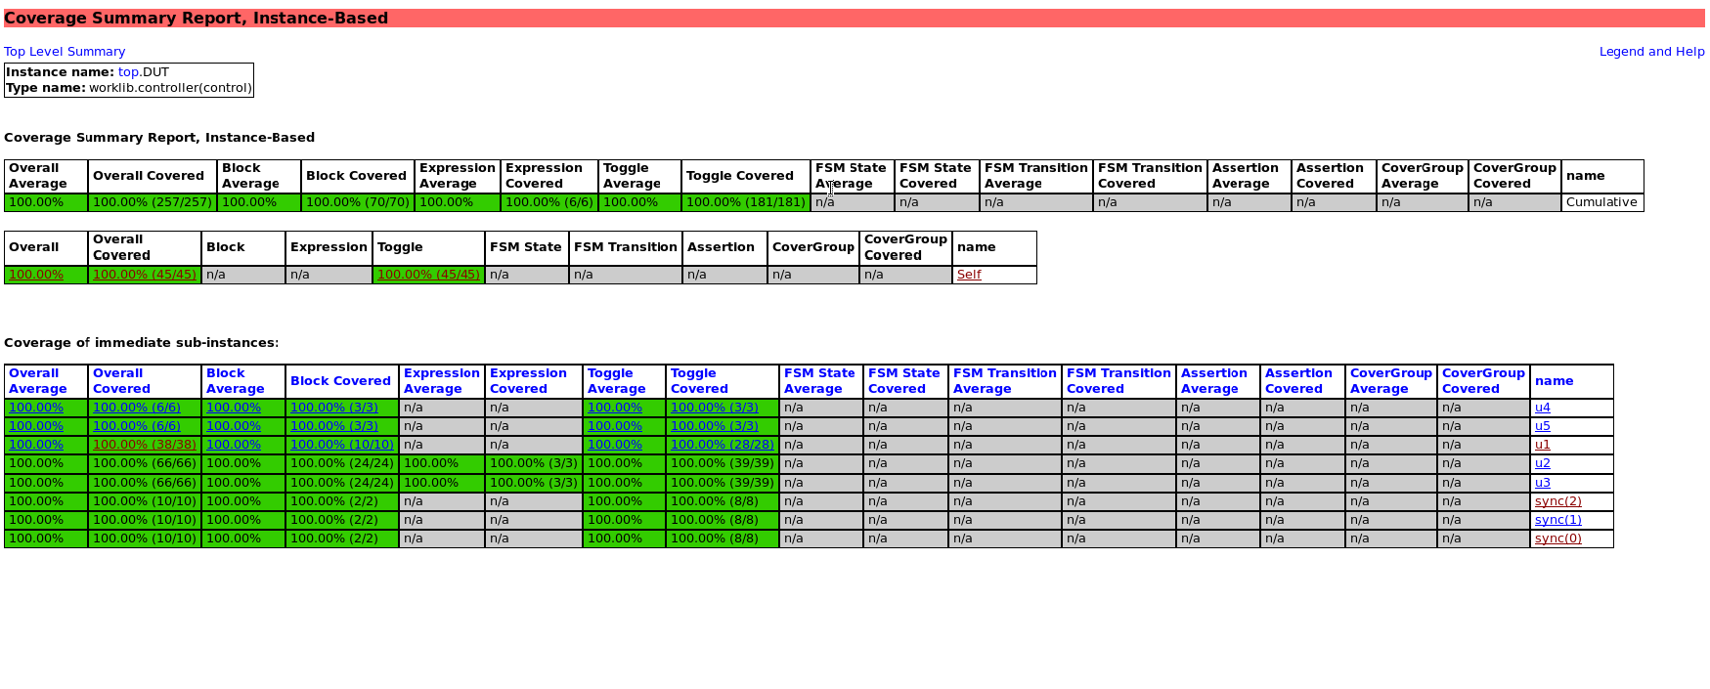
FIFO Testbench Coverage Results: Top.DUT

Slide 42


